Slide 1
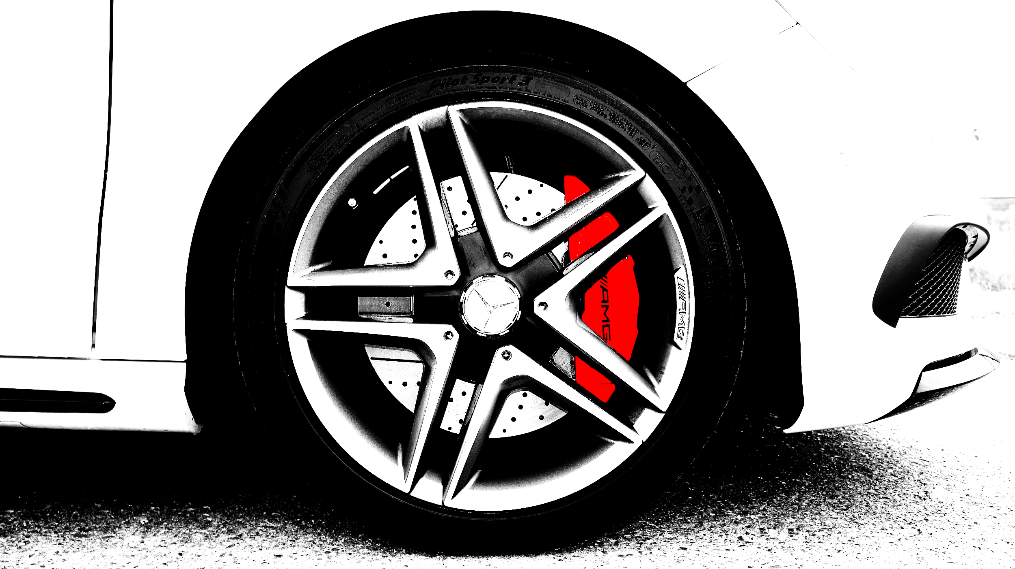
FRICTION
We will explain friction using familiar objects

Slide 2
Do not delete this slide.
This slide is designed so that you can copy the prompt box you need and insert it into your slides.
This slide is hidden and will not be included when presenting your lesson.
TRACK WITH ME
VOCABULARY
1 -
HINT
Students, remember….
CHECK FOR UNDERSTANDING
READ WITH ME
TEACHER CUE
MAKE THE CONNECTION
Students, you already know….
EXTENSION
GESTURE WITH ME

Slide 3
Sort the following examples into contact or non-contact forces.
Scooter pushed across a footpath.
Biting into a sandwich.
Magnets attracted to a fridge.
Beaker falling to the floor.
Cutting paper with scissors.
Contact forces | Non-contact forces

Slide 4

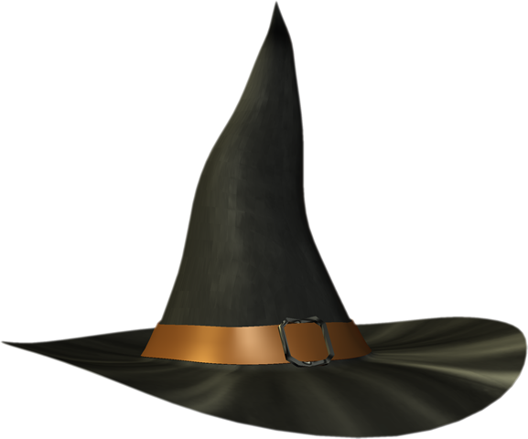

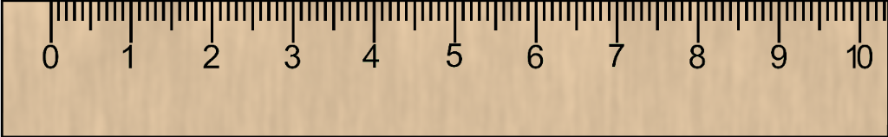
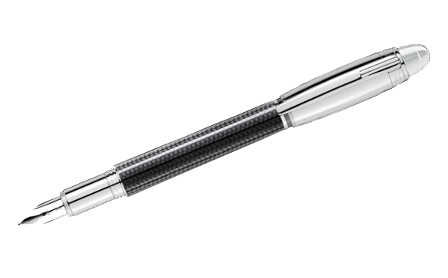

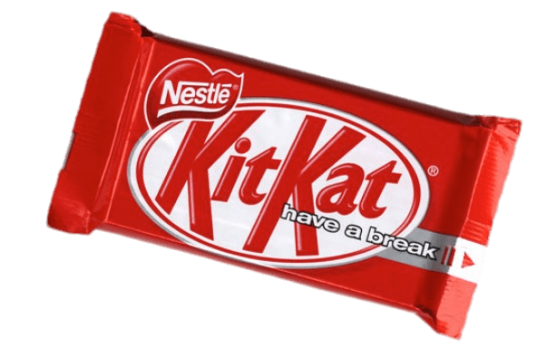


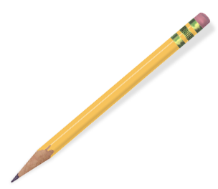
Instructions - study these 10 objects in the 30 seconds that you have been given.
One object will be taken away and you will have to guess “What's Missing”?

Slide 5
“What's Missing”?

Slide 6
Repeat the opposite word/phrase.
FORCE
PUSH, PULL OR TWIST

Slide 7
Repeat the opposite word/phrase.
SPRING BALANCE
MEASURES FORCES

Slide 8
Repeat the opposite word/phrase.
NEWTON (N)
UNIT OF FORCE

Slide 9
Repeat the opposite word/phrase.
BALANCED FORCE
EQUAL IN OPPOSITE DIRECTIONS

Slide 10
Repeat the opposite word/phrase.
UNBALANCED FORCE
UNEQUAL FORCES

Slide 11
Repeat the opposite word/phrase.
CONTACT FORCES
PHYSICAL CONTACT

Slide 12
Repeat the opposite word/phrase.
NON-CONTACT FORCES
NO PHYSICAL CONTACT

Slide 13

Calculate the net force from the diagram below.
10N
20N

Slide 14
Calculate the net force from the diagram below.
5N
25N

Slide 15
Calculate the net force from the diagram below.
10N
10N

Slide 16

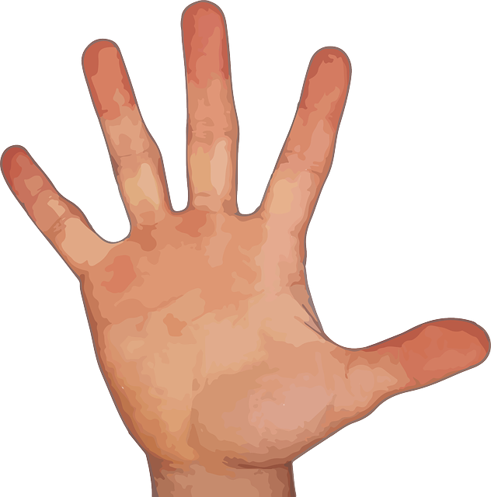
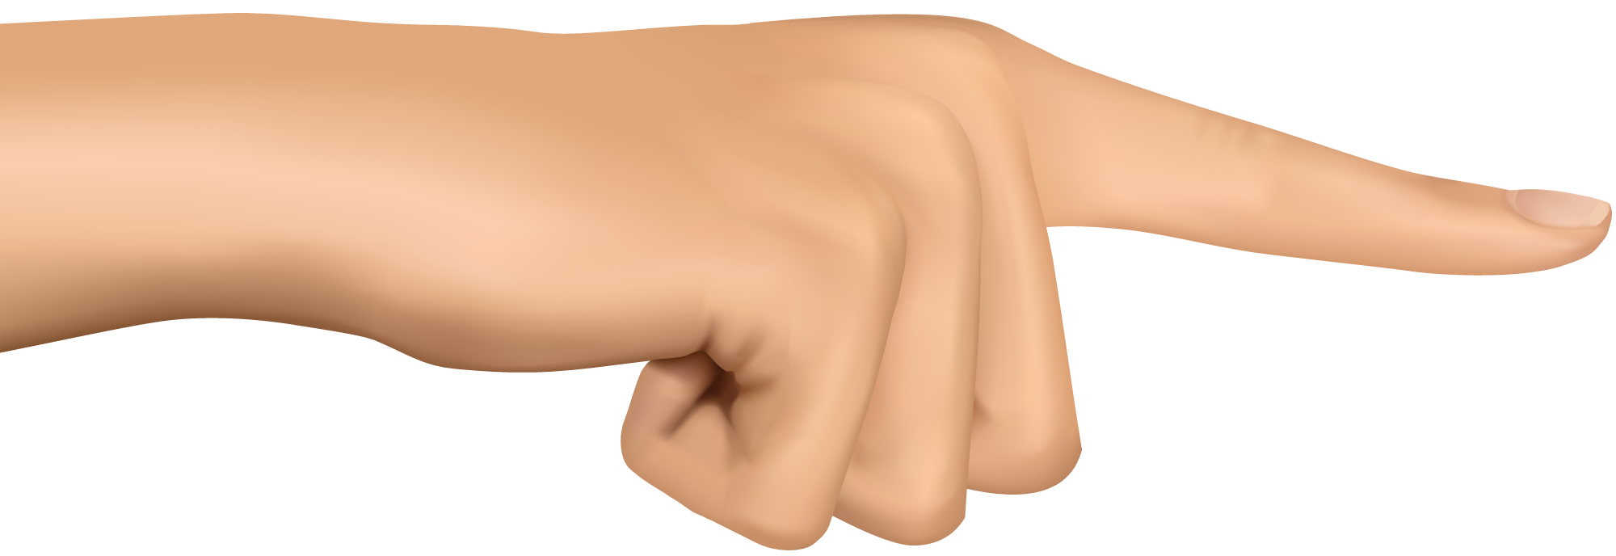
On your whiteboard, provide an example of a contact and a non-contact force.

Slide 17
We will explain₁ friction using familiar₂ objects
TRACK WITH ME
READ WITH ME
We will define friction
We will use examples to explain how friction affects other forces
DEFINITION
1 - describe 2 - well-known
DECLARE THE OBJECTIVE
Read the learning objective to your partner.

Slide 18
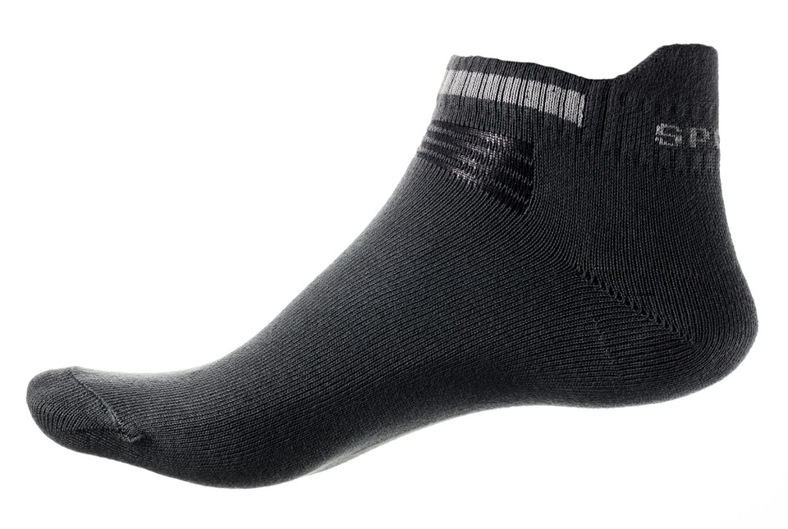
We will explain friction using familiar objects
Some floors can be slippery at times, such as tiles or floorboards.
If you wanted to slide on the floor, would it be better to be barefoot or wearing socks?

Slide 19
We will explain friction using familiar objects
Some floors can be slippery at times, such as tiles or floorboards.
If you wanted to slide on the floor, would it be better to be barefoot or wearing socks?
Which force diagram below do you think shows someone sliding on the floor wearing socks?
MAKE THE CONNECTION
Students, you already know that forces occur when two objects interact. Have a think about whether socks reduces a force or increases a force?
A
B

Slide 20
We will explain friction using familiar objects
Some floors can be slippery at times, such as tiles or floorboards.
If you wanted to slide on the floor, would it be better to be barefoot or wearing socks?
Which force diagram below do you think shows someone sliding on the floor wearing socks?
MAKE THE CONNECTION
Students, you already know that forces occur when two objects interact. Have a think about whether socks reduces a force or increases a force?
A
B

Slide 21
We will explain friction using familiar objects
Friction is the force that resists₁ movement between two objects that are touching.
For example, there is friction when you push an object on a surface. It reduces the net force.
CHECK FOR UNDERSTANDING
Looking at the diagram below, which arrow is the friction force? Justify your answer. A A B C
A
C
B
Pushing force
Friction
DEFINITION
1 - stops or slows

Slide 22
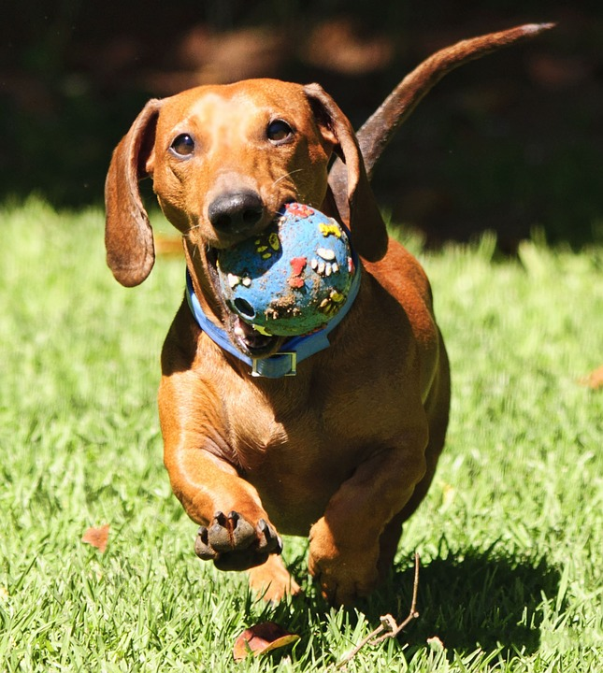

We will explain friction using familiar objects
CHECK FOR UNDERSTANDING
In the image below, friction is occurring between: dog and ground ground and ball dog and ball Justify your answer.
Friction is the force that resists₁ movement between two objects that are touching.
On a playground slide, friction can slow you down. You can reduce friction on a slide if you use a soft piece of fabric or wear soft clothes.
Pushing force
Friction
DEFINITION
1 - stops or slows

Slide 23
We will explain friction using familiar objects
Identify the objects which are being affected₁ by friction forces in the examples below.
CHECK FOR UNDERSTANDING
If friction increases, do objects slow down or speed up? Justify your answer.
Example | Two objects being affected by friction
Scooter down a hill
Using an iPad
Sweeping the floor
REMEMBER THE CONCEPT
Remember that friction is the force that resists movement between two objects that are touching.
DEFINITION
1 - impacted

Slide 24
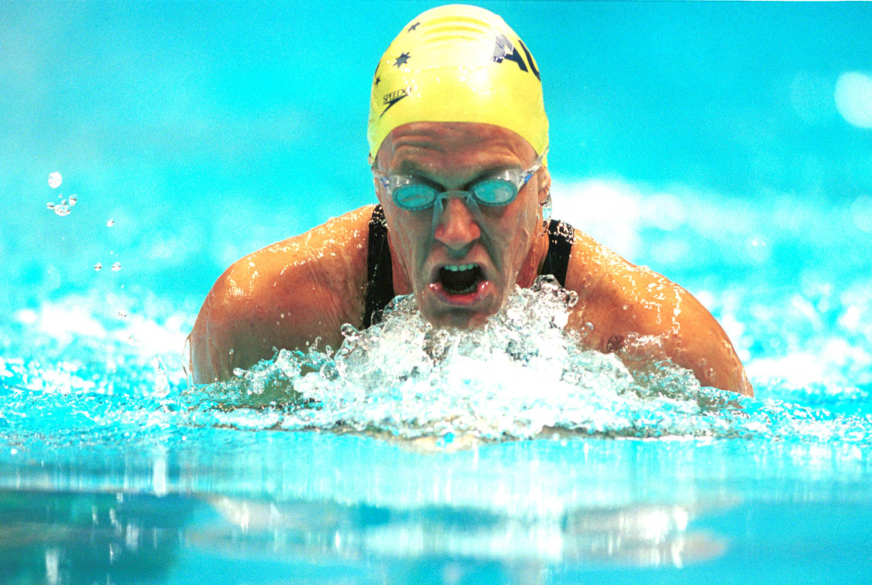
We will explain friction using familiar objects
Friction is the force that resists₁ movement between two objects that are touching.
We sometimes increase friction when we want something to stop or slow down. Such as catching a ball or opening a jar.
We can also reduce friction when we want something to stay moving or speed up. Such as a swimming race.
CHECK FOR UNDERSTANDING
Can you think of an example from Phys. Ed. where you might need to increase or reduce friction?
DEFINITION
1 - stops or slows 2 - impacts

Slide 25
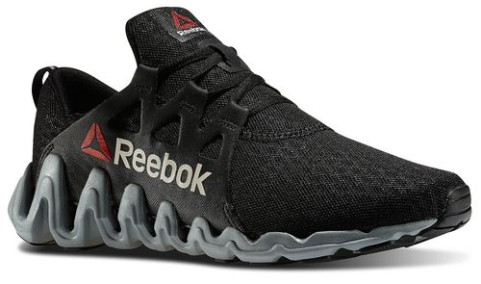
We will explain friction using familiar objects
CHECK FOR UNDERSTANDING
You are playing basketball and notice you are sliding all over the place on the court. Your shoes are worn out and you need new ones. Below is a force diagram of you slipping on the court. Draw a force diagram if your shoes were working properly.
Friction is the force that resists₁ movement between two objects that are touching.
It is a contact-force and affects₂ every object which touches another object.
Pushing force
Friction
DEFINITION
1 - stops or slows

Slide 26
We will explain friction using familiar objects
For each of the following examples, identify the two objects which are affected by friction.
Draw a force diagram of each example and label the friction force.
CHECK FOR UNDERSTANDING
Using an example, what is friction?
Example | Two objects being affected by friction |  | Force Diagram
Closing a window
Skateboard slowing down
Cleaning a whiteboard
REMEMBER THE CONCEPT
Remember that friction is the force that resists movement between two objects that are touching.

Slide 27
We will explain₁ friction using familiar₂ objects
We will define friction
We will use examples to explain how friction affects other forces
DEFINITION
1 - describe 2 - well-known
CHECK FOR UNDERSTANDING
Check Success Criteria.

